Slide 1
CAS NLP Module 4
Project Idea 2: Multilingual Named Entity Recognition (MNER)
Julia Degelo & Beatrice Bircher

Slide 2
Task
Build a Multilingual Named Entity Recognition (NER) system using transformer models. The goal is to identify named entities (e.g., persons, organizations, locations) in texts across multiple languages (at least for 3 languages) without training separate models for each language. The project will focus on fine-tuning a multilingual model and exploring how effectively it can perform NER in multiple languages. For evaluation, compare the performance of the models using appropriate metrics. Also, check if the model generalizes across languages and analyze any language-specific challenges.

Slide 3
Agenda
Define languages: EN, DE, FR, IT
Choose a model and a dataset
Know your data
Preprocess the data
Train and test the model in EN
Test the model in DE, FR and IT
Results
Possible improvement
Contrast approaches
Limitations of approach
Learnings
Discussion

Slide 4
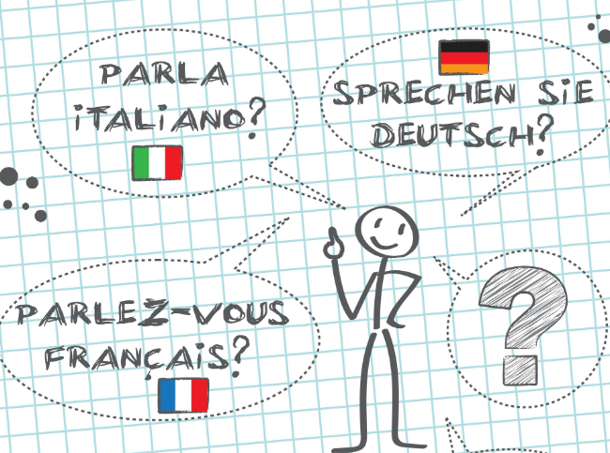
Define languages: EN, DE, FR, IT
We decided to take these languages because they are the official languages at the FDFA and because we both know them at least a bit.

Slide 5
Choose a model and a dataset
Model: WikiNeural Multilingual NER: a state-of-the-art named entity recognition model that supports 9 different languages. Built by Babelscape, it's based on mBERT and fine-tuned on the WikiNEuRal dataset, specifically designed to address the challenge of data scarcity in multilingual NER tasks.
wikineural-multilingual-ner
Dataset: WikiANN from unimelb: (sometimes called PAN-X) is a multilingual named entity recognition dataset consisting of Wikipedia articles annotated with LOC (location), PER (person), and ORG (organisation) tags in the IOB2 format. This version corresponds to the balanced train, dev, and test splits of Rahimi et al. (2019), which supports 176 of the 282 languages from the original WikiANN corpus.
train-test-split for EN, FR, IT and DE
unimelb-nlp/wikiann · Datasets at Hugging Face
Train | Validation | Test
20000 | 10000 | 10000
Notes:
Model:
According to Perplexity:
While the other models (google-bert/bert-base-multilingual-cased and FacebookAI/xlm-roberta-base) are also multilingual, they are not specifically fine-tuned for NER tasks. The wikineural-multilingual-ner model's specialized training on NER tasks across multiple languages makes it the most suitable choice for your specific requirements.
Advantages with this model:
Language support: This model supports all four required languages (English, French, Italian, and German)
Multilingual NER capability: It is specifically designed for Named Entity Recognition (NER) tasks across multiple languages
Transfer learning potential: The model is trained on a large dataset derived from Wikipedia, combining neural and knowledge-based approaches. This makes it suitable for transfer learning from English to other languages
Performance: It achieves state-of-the-art results in multilingual NER tasks
Fine-tuning flexibility: We can fine-tune this model on English data and then apply it to the other languages due to its multilingual nature
Dataset:
Advantages:
Trained on Wikipedia texts
In all for us relevant language the size of the train-test-valuation set is identical
IOB2 format: many modern NLP tools support this format

Slide 6
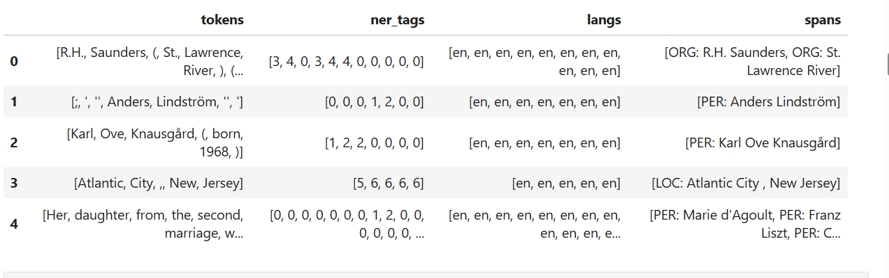
Know your data
Structure of first 5 entries of training sets
Notes:
(be)
These are the first five rows of the DataFrame created from the WikiANN dataset en:
Structure: The DataFrame has four columns: 'tokens', 'ner_tags', 'langs', and 'spans'.
Column details:
tokens: Lists of words or punctuation marks that make up each text sample.
ner_tags: Numerical tags corresponding to Named Entity Recognition (NER) categories: label_map = {0: 'O', 1: 'B-PER', 2: 'I-PER', 3: 'B-ORG', 4: 'I-ORG', 5: 'B-LOC', 6: 'I-LOC'}
langs: Language identifiers for each token (all 'en' for English in this sample).
spans: Named entities identified in the text, with their categories.

Slide 7
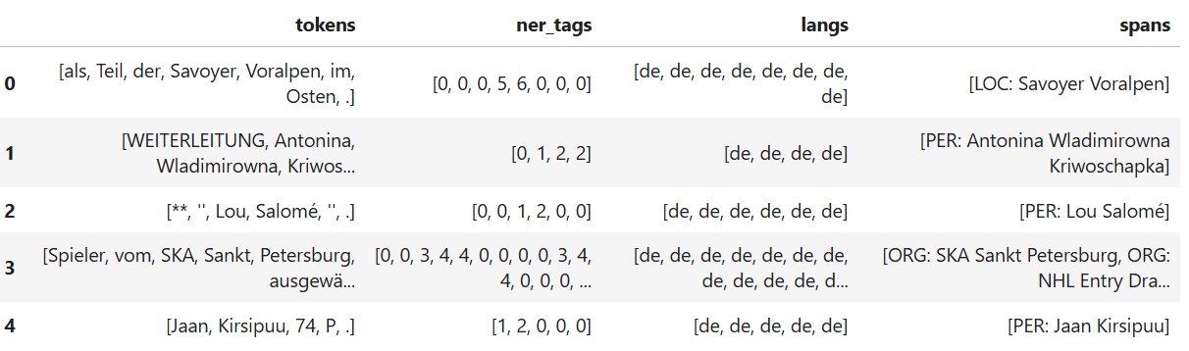
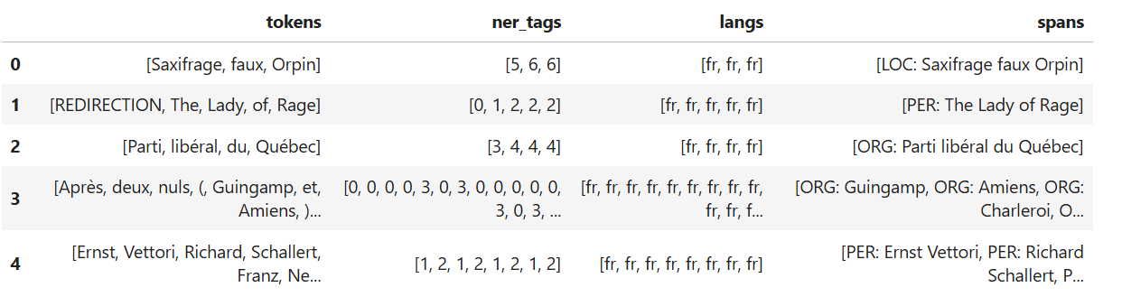
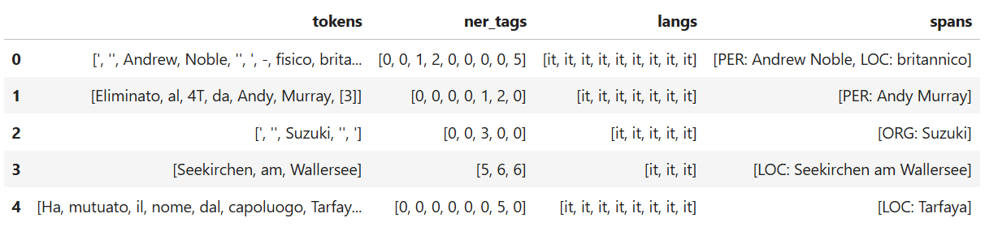
Notes:
Similar in the languages DE, FR and IT
label_map = {0: 'O', 1: 'B-PER', 2: 'I-PER', 3: 'B-ORG', 4: 'I-ORG', 5: 'B-LOC', 6: 'I-LOC'}

Slide 8
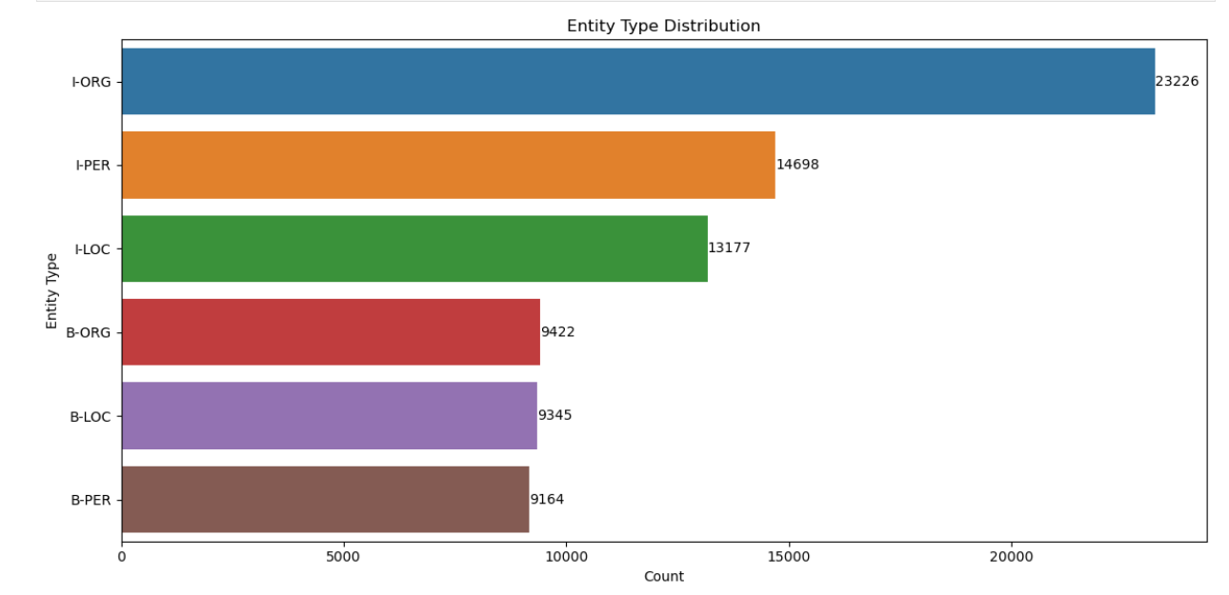
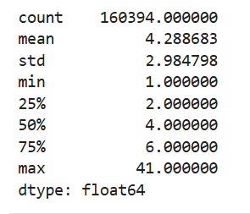
Entity distribution and token lenght before customized preprocessing EN
Notes:
(be)
EN: I-ORG has the most followed by I-PER
Interpretation of token length:
count (160394.000000): This is the total number of tokens in your dataset. You have 160,394 individual tokens.
mean (4.288683): The average length of a token is about 4.29 characters.
std (2.984798): The standard deviation is about 2.98 characters, indicating a moderate spread in token lengths.
min (1.000000): The shortest token(s) in your dataset is 1 character long.
max (41.000000): The longest token in your dataset is 41 characters long.
Percentiles: 25% (2.000000): 25% of tokens are 2 characters or shorter.
50% (4.000000): The median token length is 4 characters. Half of the tokens are 4 characters or shorter.
75% (6.000000): 75% of tokens are 6 characters or shorter.

Slide 9
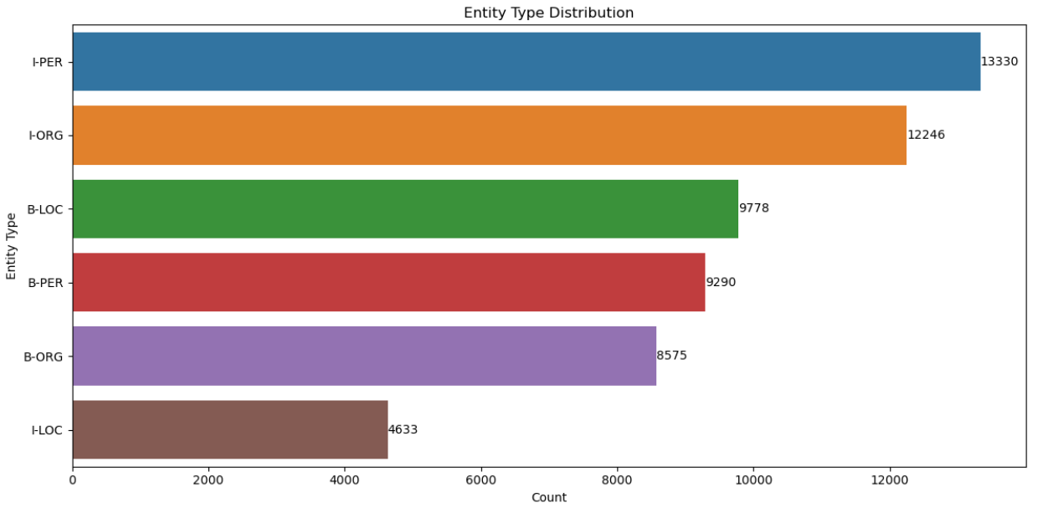
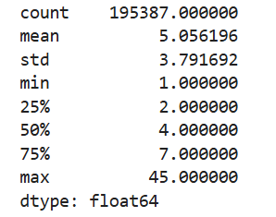
Entity distribution and token lenght before customized preprocessing DE
Notes:
DE: I-PER has the most followed by I-ORG (vice versa for I-PER and I-ORG than in EN, FR and IT. The reason for that could be of the word compounds, the morphological complexity of German or the cultural differences between these languages.
Here are three possible reasons proposed by Perplexity:
- Compound nouns: German is known for its long compound nouns, which could lead to more I-PER (inside-person) tags for multi-word person names (Universal NER: A Gold-Standard Multilingual Named Entity Recognition Benchmark)
- Morphological complexity: German has a rich morphological system, which might affect how names are recognized and tagged in NER systems (Dataset Enhancement and Multilingual Transfer for Named Entity Recognition in the Indonesian Language)
- Cultural differences: German texts might include more detailed person names or titles, resulting in longer person entity mentions (2024.naacl-long.243.pdf)

Slide 10
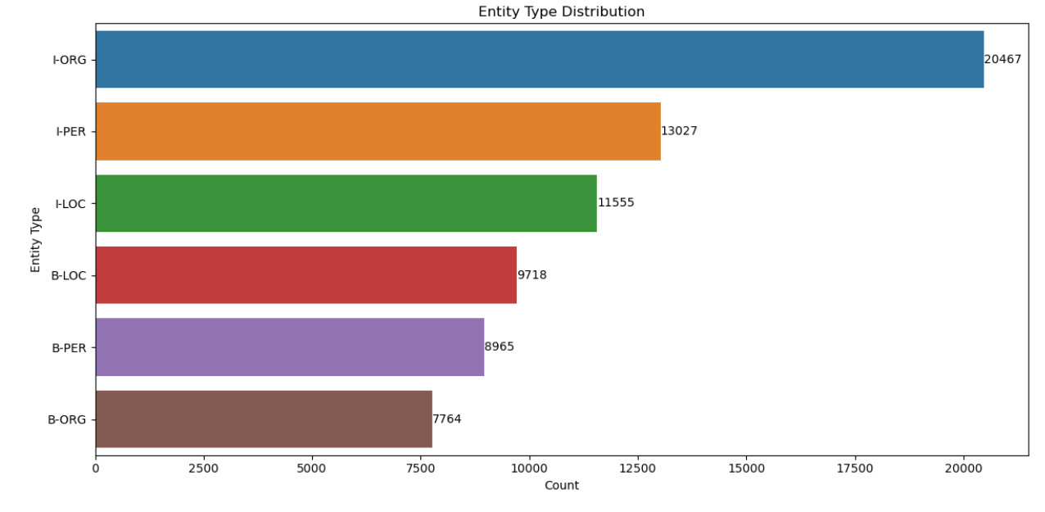
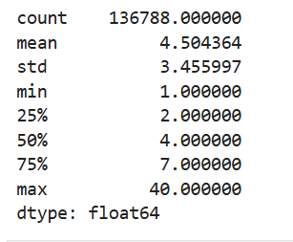
Entity distribution and token lenght before customized preprocessing FR
Notes:
FR: I-ORG has the most followed by I-PER

Slide 11
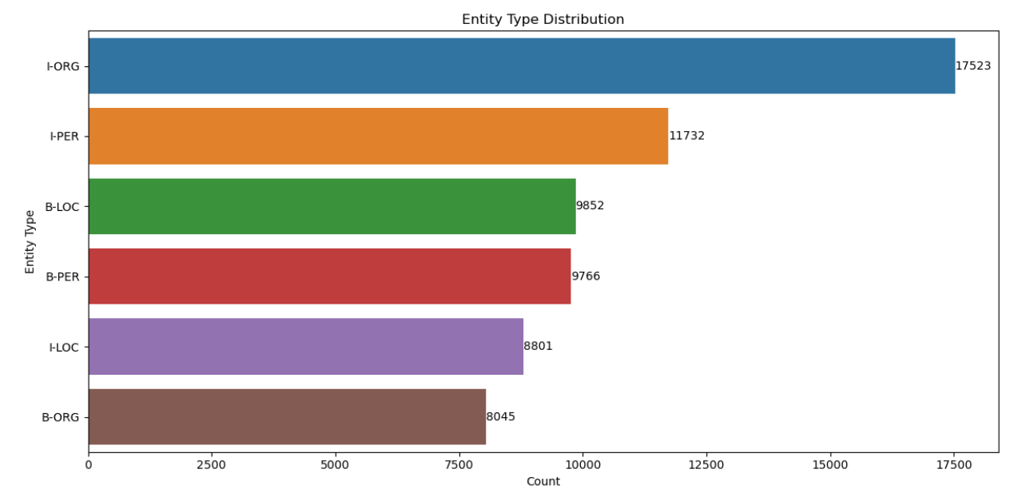
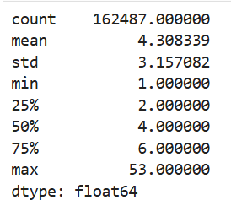
Entity distribution and token lenght before customized preprocessing IT
Notes:
IT: I-ORG has the most followed by I-PER

Slide 12
Token length
Most tokens in our dataset are relatively short, with half being 4 characters or less.
There's a wide range of token lengths (from 1 to 41 characters), but the majority are clustered around the mean of 4.29 characters.
The presence of very long tokens (up to 41 characters) might indicate compound words, technical terms, or possibly some preprocessing issues that need attention.
Notes:
(be)

Slide 13
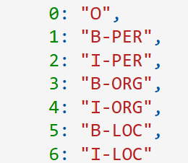
Preprocess the data
Remove punctuation and empty tokens in all splits (train, test, validation)
Define label list = 0, B-PER, I-PER, B-ORG, I-ORG, B-LOC, I-LOC
Map numeric labels to string labels
Tokenize dataset
Apply mapped labels to tokenized dataset
Visualize distribution of beginning of entities (B-PER, B-ORG, B-LOC) in preprocessed datasets
Notes:
(ju)
We have removed the punctuation, as many tokens only consisted of punctuation during the first run.
The labels in the dataset are numeric so we had to match the numeric labels to our chosen labels (labels according to the IOB format).
We also did a visualization to see if there were any big changes between the original and the preprocessed dataset.
101: [CLS] token, which signals the start of the sequence. 102: [SEP] token, which marks the end of the sequence.

Slide 14
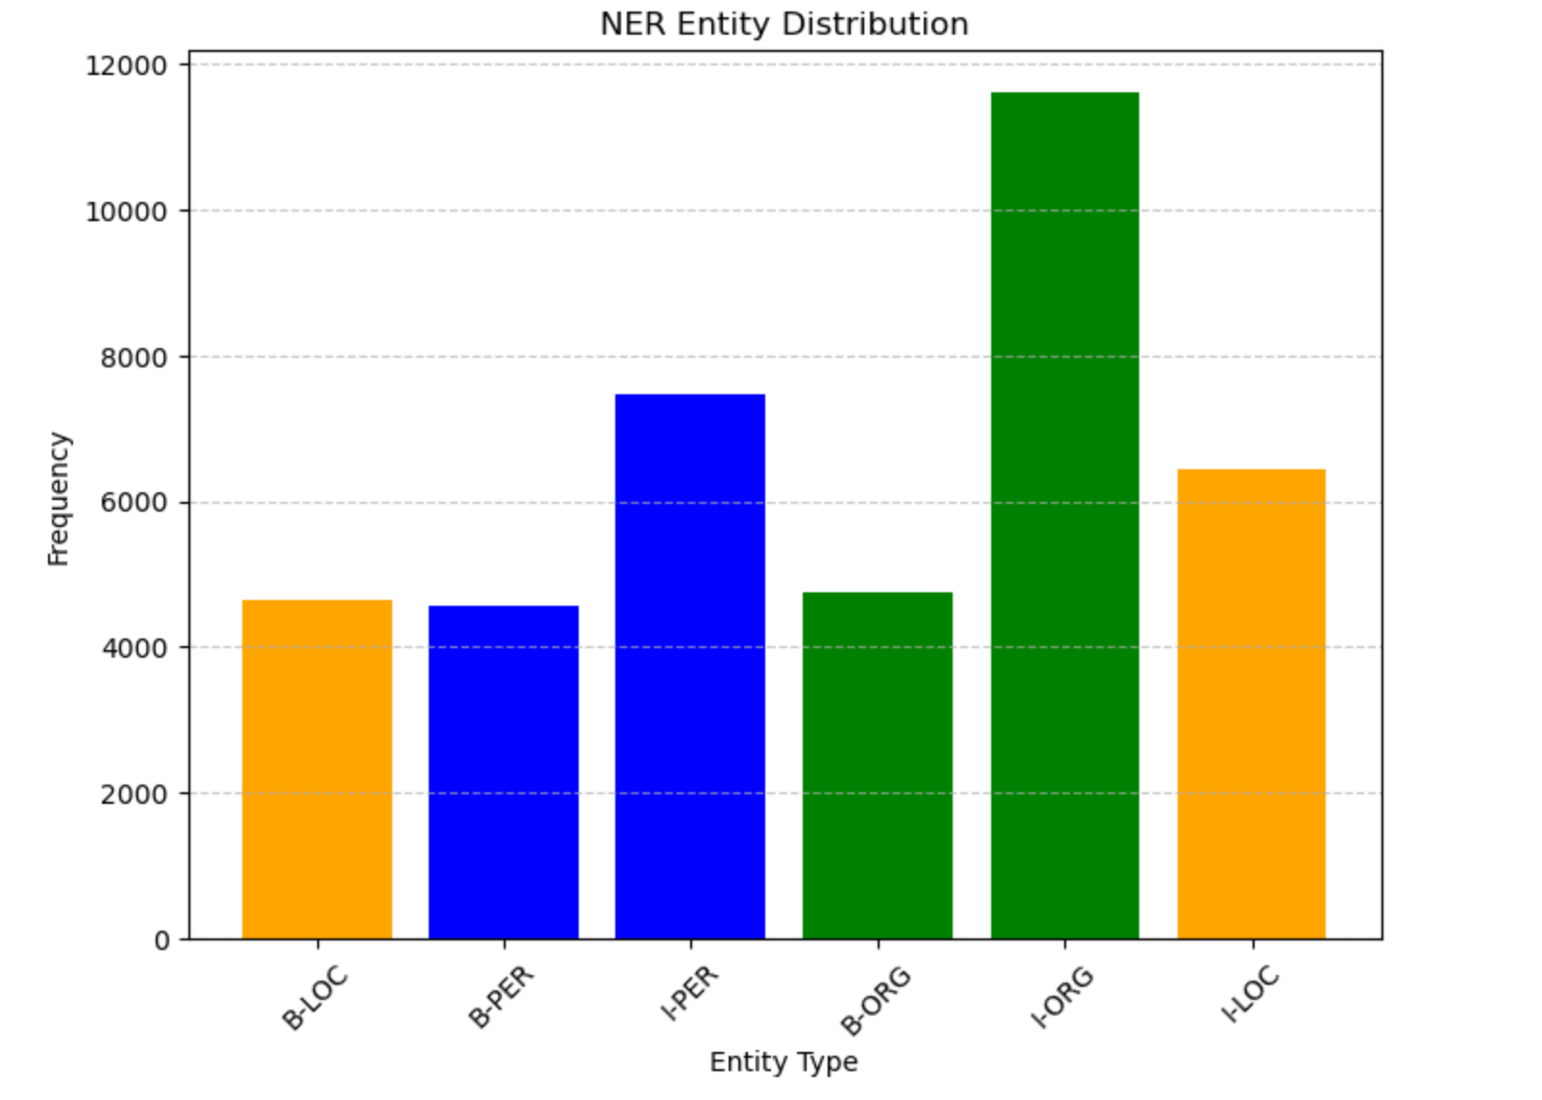
Distribution of entities Dataset EN
Notes:
There are more I than B tagged entities in all entity types.

Slide 15
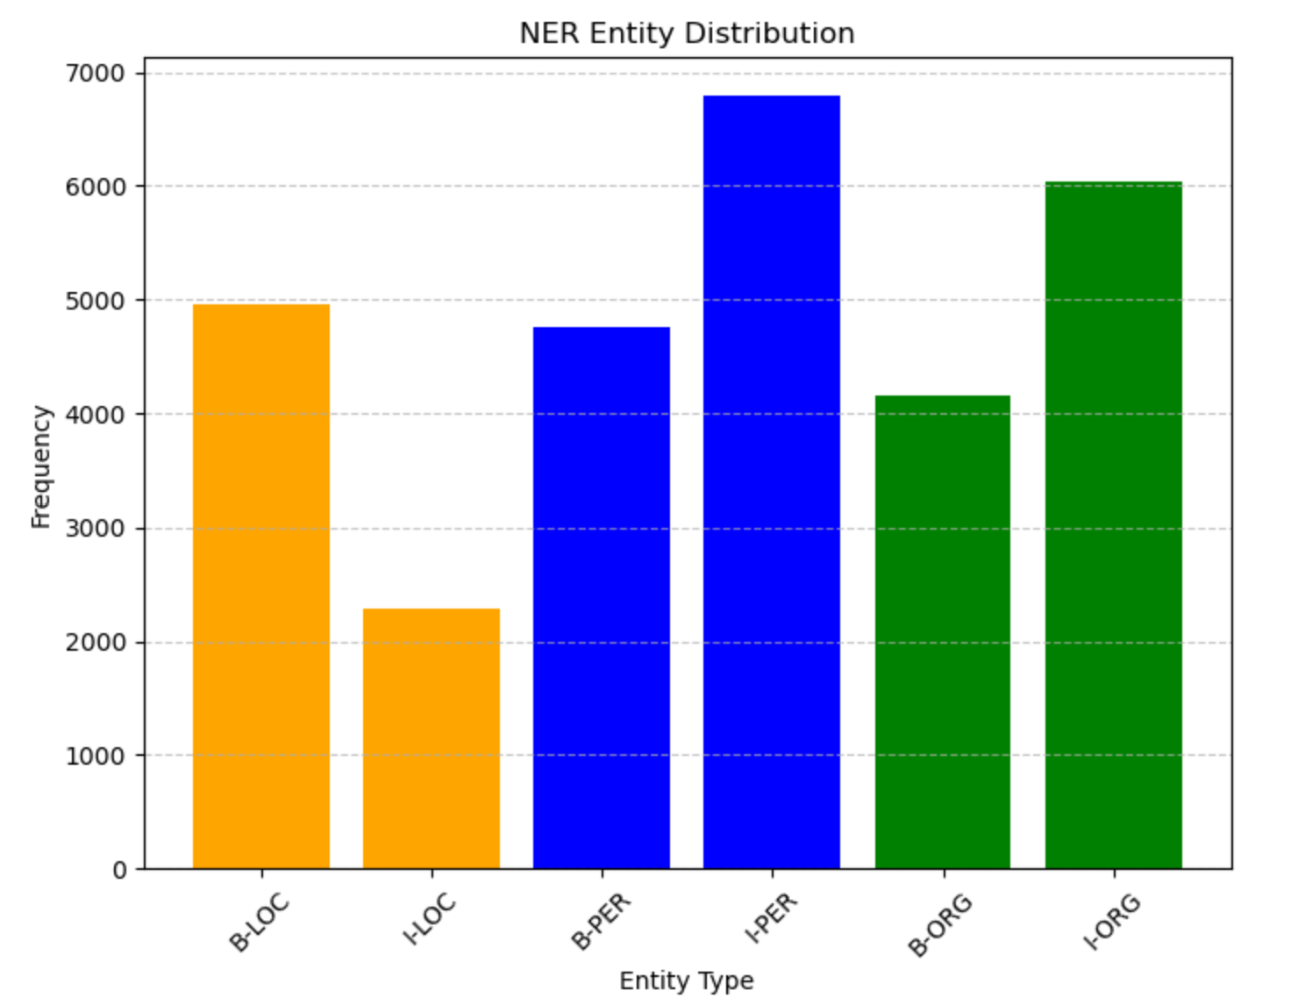
Distribution of entities Dataset DE
Notes:
More B tagged entities in the location entities.

Slide 16
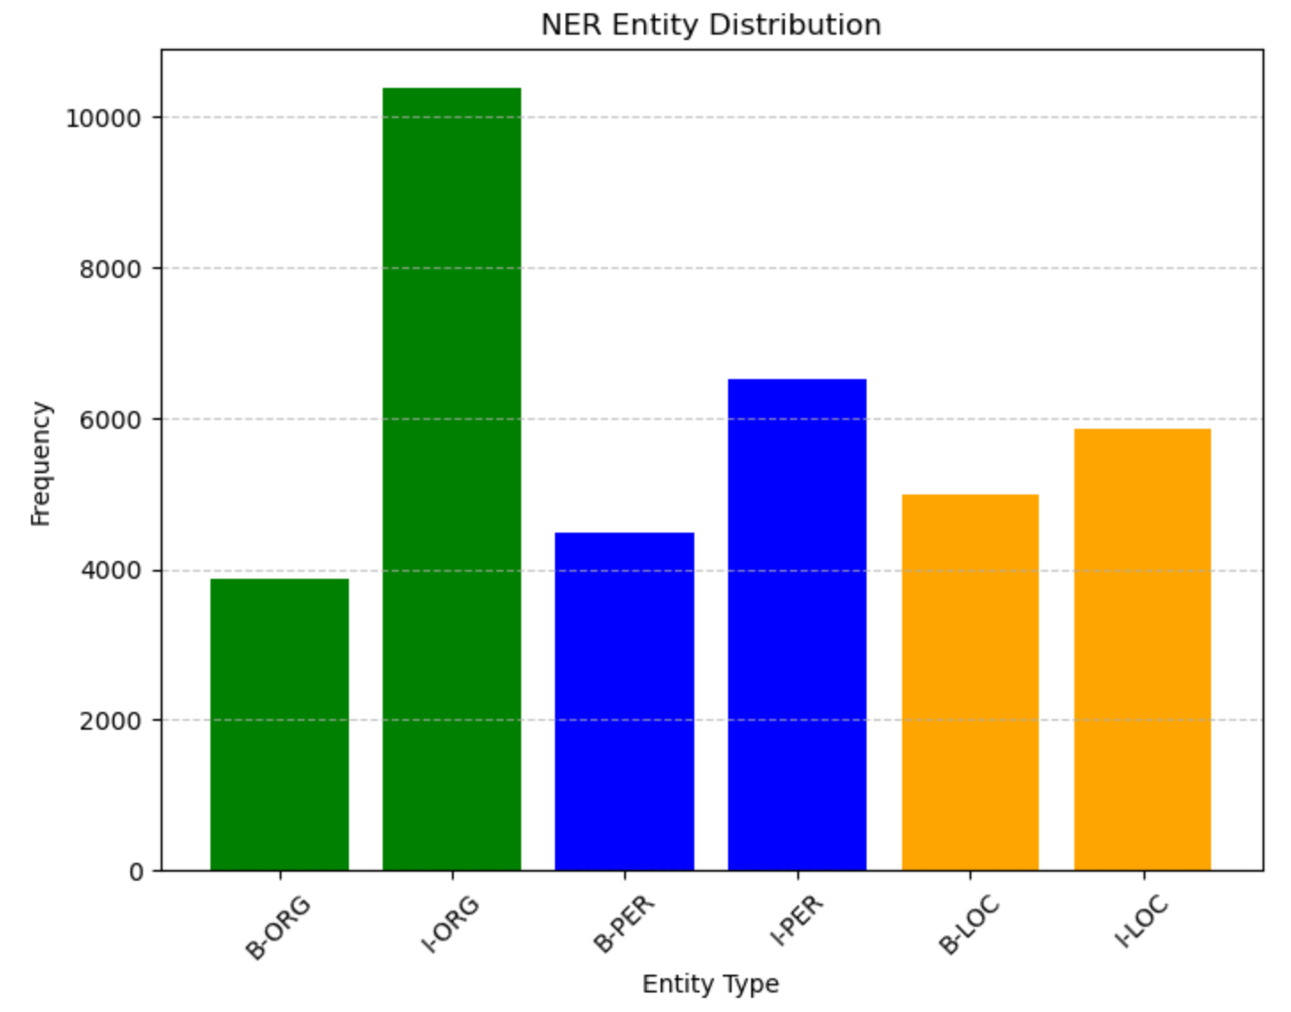
Distribution of entities Dataset FR
Notes:
There are more I than B tagged entities in all entity types.

Slide 17
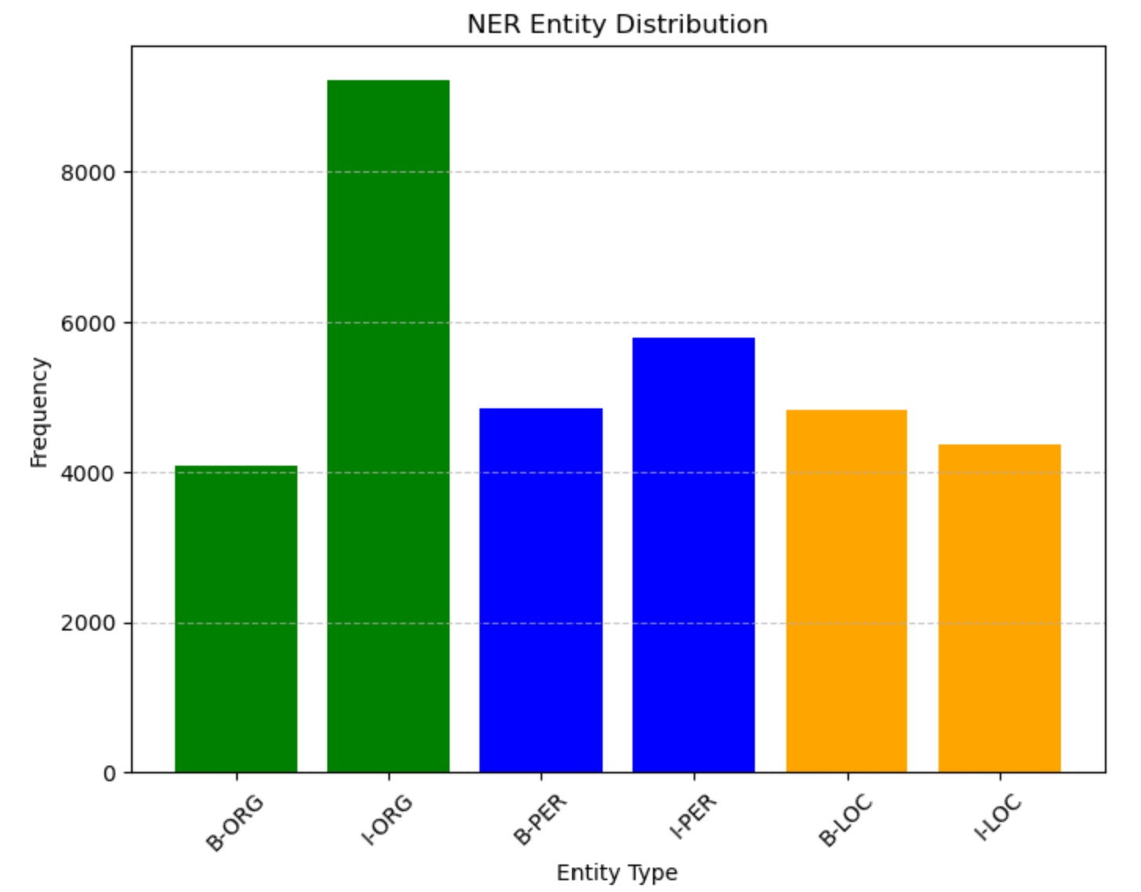
Distribution of entities Dataset IT
Notes:
More B tagged entities in the location entities.
The differences between the languages could stem from different annotation styles. With persons and organizations, on the other hand, it is clear: as these often consist of several tokens, there are more I tagged entities here in all languages. The fact that there are more B tagged entities in LOC in German and Italian could be due to the fact that German and Italian place names increasingly consist of only one word. But that is just a hypothesis.

Slide 18
Train and test the model in EN
Monolingual vs. multilingual training:
Less computational power needed
Simpler setup, faster training
Zero-shot-cross-lingual capacities of the models can be used
Evaluation of cross-lingual transfer is easier
Less complicated because no data fusion necessary
Easier to recognize generalization and language specific challenges

Slide 19
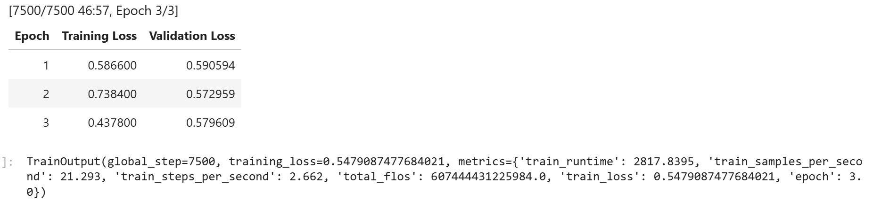
Training on EN dataset
Training took very long, so we adjusted some parameters:
learning_rate=1e-5
per_device_train_batch_size=8
num_train_epochs=3
Notes:
(ju)
Load model (Wikineural from Babelscape), map string labels to numeric labels of model, load train, test and validation split, create data collator (helps us to format and pad the batches), create trainer, train, save fine tuned model
- Tendency to overfitting
Training loss: the smaller the better, 0 would be ideal
Validation loss: the smaller the better, 0 would be ideal

Slide 20
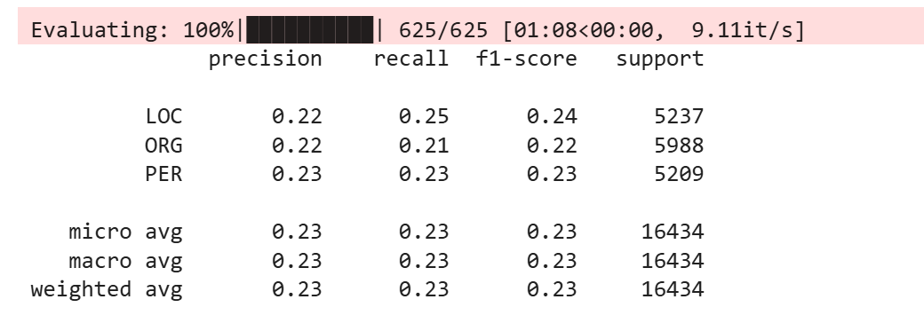
Evaluate model on EN dataset
Create data loader
Padding sequences to the maximum length in the batch
Evaluation report
Notes:
(ju)
For the evaluation we used the python library seqeval.
Precision answers the question: "Out of all the positive predictions we made, how many were true? (e.g. LOC: 22% of predicted LOC labels were correct)
Recall answers the question: "Out of all the data points that should be predicted as true, how many did we correctly predict as true?“ (e.g. LOC: 25% of actual LOC labels were correctly identified)
The F1-score is a single metric that combines precision and recall, providing a balanced measure of a model's performance (our model is below average)
Support: e.g. LOC: there were 5237 LOC entities in the dataset
Accuracy is not so suitable for NER tasks, as it quickly becomes meaningless. For example, there are often many 0 labels and if the model then simply predicts all tokens with 0, it can still achieve a high level of accuracy without recognizing any “real” labels.

Slide 21
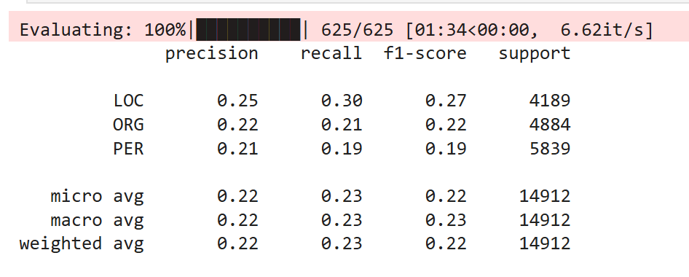
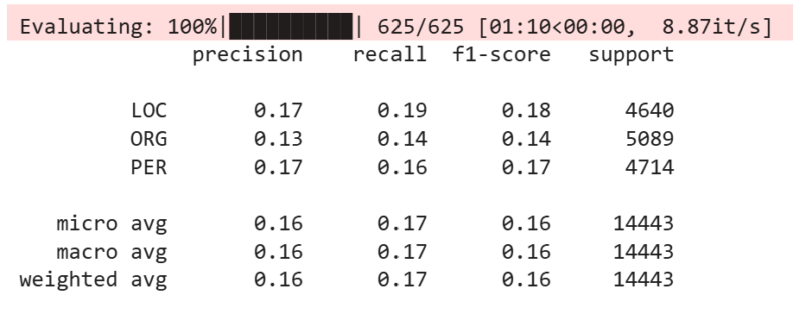
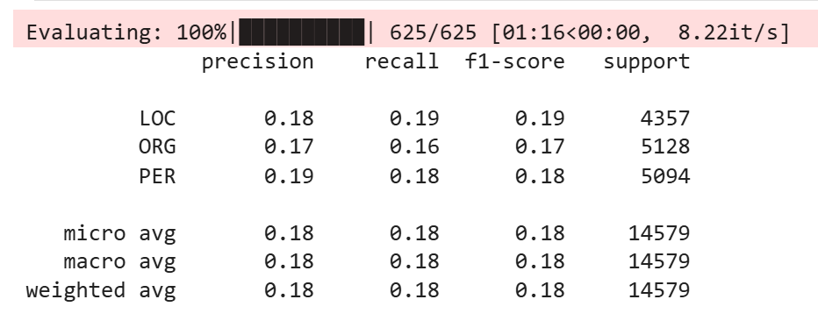
Evaluate the model in DE, FR and IT
DE
FR
IT
Notes:
As you can see the model performed even worse in French and Italian, which is not surprising since we did a zero shot cross lingual transfer (which means we only trained the model in English and then applied it to other languages). It performs as bad in German as it does in English, which is a little better than in French and Italian. This could be because French and Italian both belong to another family of languages than German and English.

Slide 22
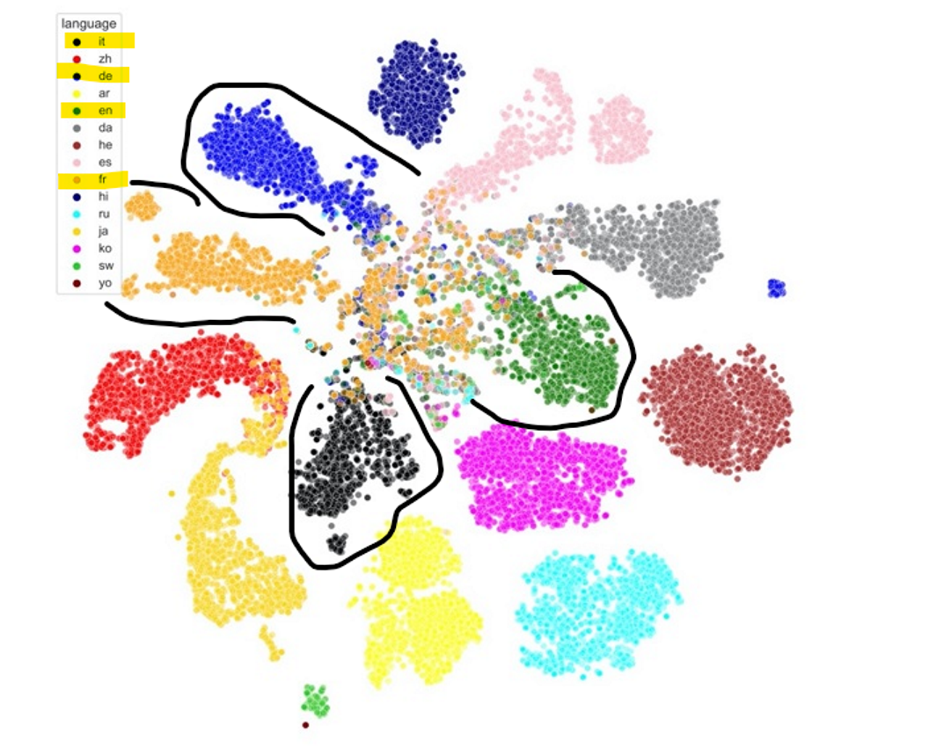
From: Issue #153 - Language Clustering for Multilingual Named Entity Recognition
Notes:
Kyle Shuffer: Two-dimensional plot of sentences after being encoded by fine-tuned XLM-R model.
The figure shows how languages are clearly separated by the fine-tuned XLM-R model, and additionally displays intuitive overlap between some languages, such as that seen between Chinese and Japanese in the lower-left corner of the figure. The languages we used include: Italian (it), Chinese (zh), German (de), Arabic (ar), English (en), Danish (da), Hebrew (he), Spanish (es), French (fr), Hindi (hi), Russian (ru), Japanese (ja), Korean (ko), Swahili (sw) and Yoruba (yo).

Slide 23
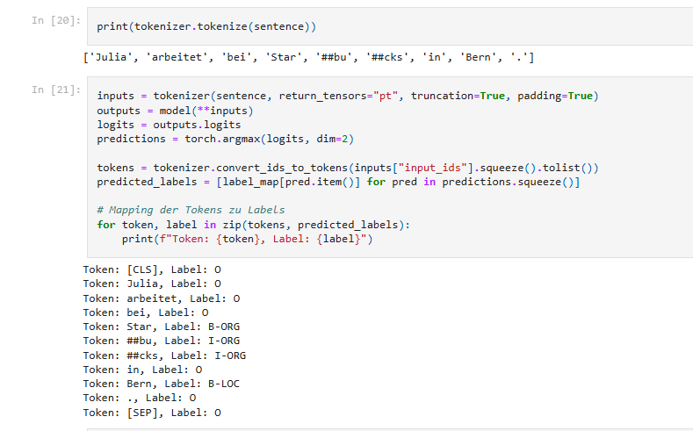
Results
Notes:
The results are pretty bad. We tested the model with sentences and realized that the labels of the persons weren’t recognized correctly.
label_map = {0: 'O', 1: 'B-PER', 2: 'I-PER', 3: 'B-ORG', 4: 'I-ORG', 5: 'B-LOC', 6: 'I-LOC'}

Slide 24
Possible improvement
To improve the model we could:
Improve the datasets
Increase the learning rate
Increase the batch size
Increase epochs
Apply early stopping
…
Notes:
There are several ways to improve the model. But due to resource constraints we refrain from doing so.

Slide 25
Contrast approaches
Flair
Convert arrow files to txt files in ConLL format
Create embeddings with GloVe
Train model on English
Save fine tuned model
Use fine tuned model on German, French and Italian
Notes:
(ju)
Arrow file = a column-oriented format that is well suited for large amounts of data
ConLL file = Conference on Natural Language Learning, a text file in a table-like structure
Flair cannot work with arrow files.

Slide 26
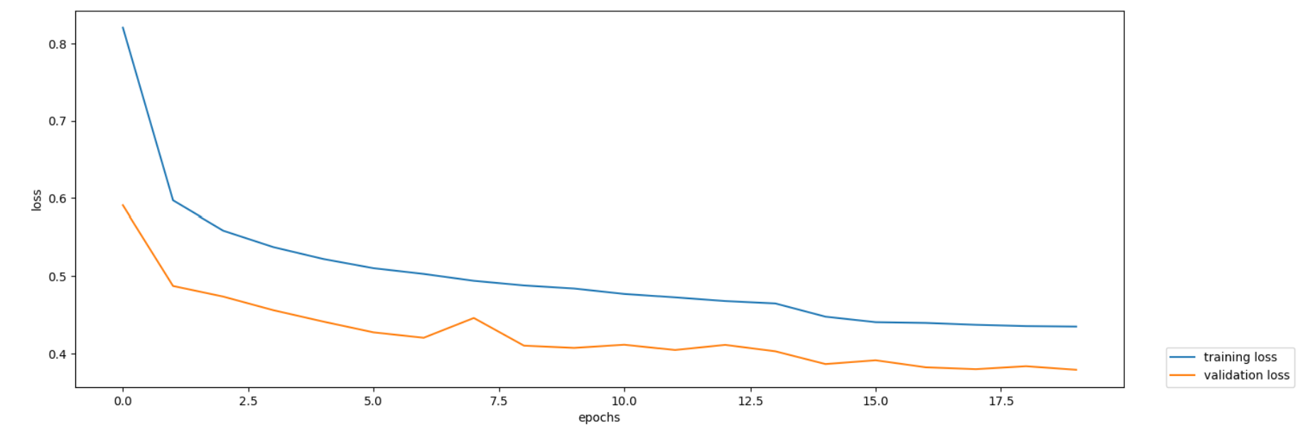
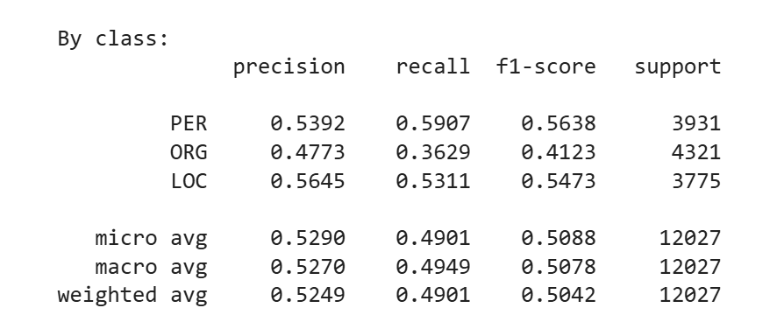
Results for English
Notes:
As you can see the performance is better with the Flair model than the performance of our fine tuned transformers model.

Slide 27
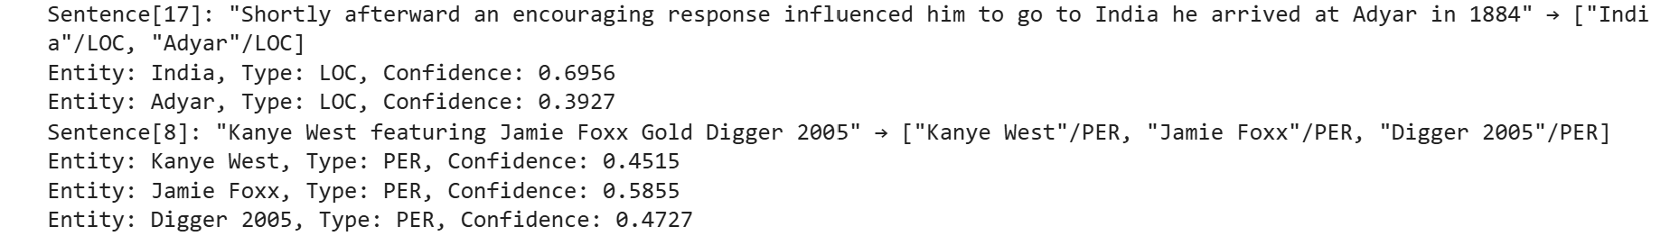
Results for English

Slide 28
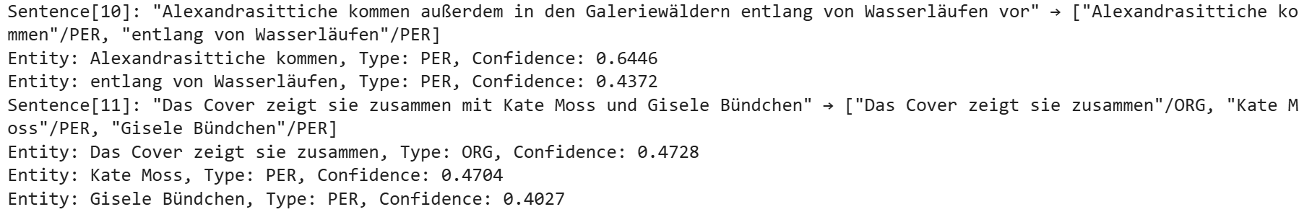
Results for German
Notes:
For German, French and Italian we didn’t do a whole evaluation report. We also just used the first 10 sentences to see how the fine tuned model would perform.

Slide 29
Results for French
Notes:
As you can see the performance is quite bad in French.

Slide 30
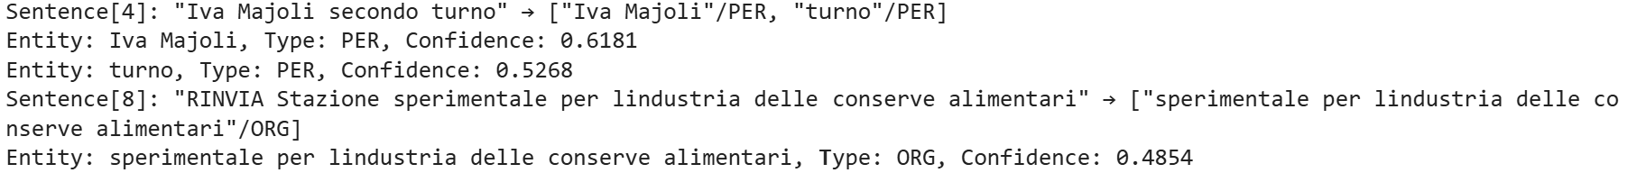
Results for Italian
Notes:
It is also quite bad in Italian.

Slide 31
Limitations of approach
Not explicitly optimized to multilingualism
Didn’t learn enough patterns to compare the languages
Therefore is not reliable on low resource languages
Very likely to overfit in one language

Slide 32
Learnings
Concerning the task:
Label list in strings vs. numbers can be more handy > label map is useful
Some very long sentences may distort the results
English and German are not necessarily closer to each other than English and Italian or English and French
In General:
It was very effective and fun to work together on this.
Getting used to the environment with GitHub, Huggingface and Ubelix
The Internet at Starbucks is pretty bad ;).

Slide 33

Discussion

Slide 34


